Slide 1


Google Search analysis in python
By: Arjun , Sonam & Sandipan

Slide 2

INTRODUCTION
Approximately 3.5 billion searches are performed on Google daily, which means that approximately 40,000 searches are performed every second on Google. So Google search is a great use case for analysing data based on search queries. Google doesn’t give much access to the data about daily search queries, but another application of google known as Google Trends can be used for the task of Google search analysis. Google Trends provides an API that can be used to analyse the daily searches on Google. This API is known as pytrends. Pytrends is an unofficial Google trends API used in python. It helps to analyze and list out the most popular Google search results on a specific topic or a subject, based on different regions and languages.

Slide 3

Background Study
In this project we are doing google analysis in two modes, one for flight booking details and another for trending search data on google.
We have used the libraries ,pandas ,matplotlib, etc. for data analysis and plotting graph.
We have also used pyrtends which is an API used for connecting to google and fetching the search data from google trends.
We have used csv file which stores the recorded data.

Slide 4

Problem statement:
Our project helps to fetch the data from the recorded csv file for the flight tickets and to fetch the data from google. Analysis of data is done from fetching the data from google through pytrends and csv is used to store the flight ticket details

Slide 5

Solution Approach
We have used pandas and matplotlib for analysing the data.
We have used pytrends for fetching data from google.
We have used conditions and loops.
Functions are also used.

Slide 6
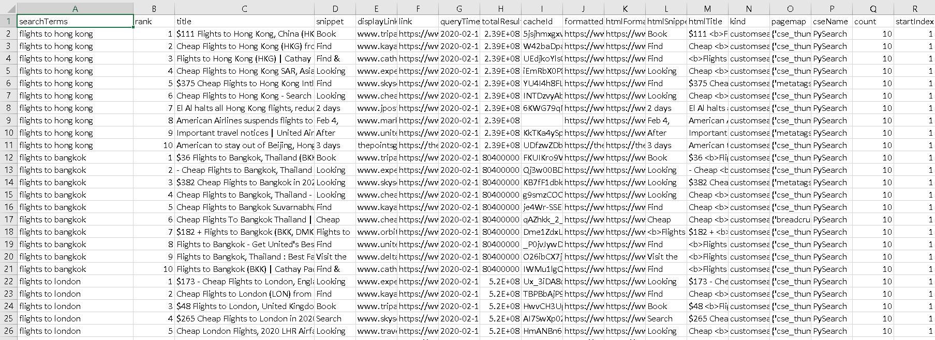
Dataset
The data we have used is from google trends and csv

Slide 7
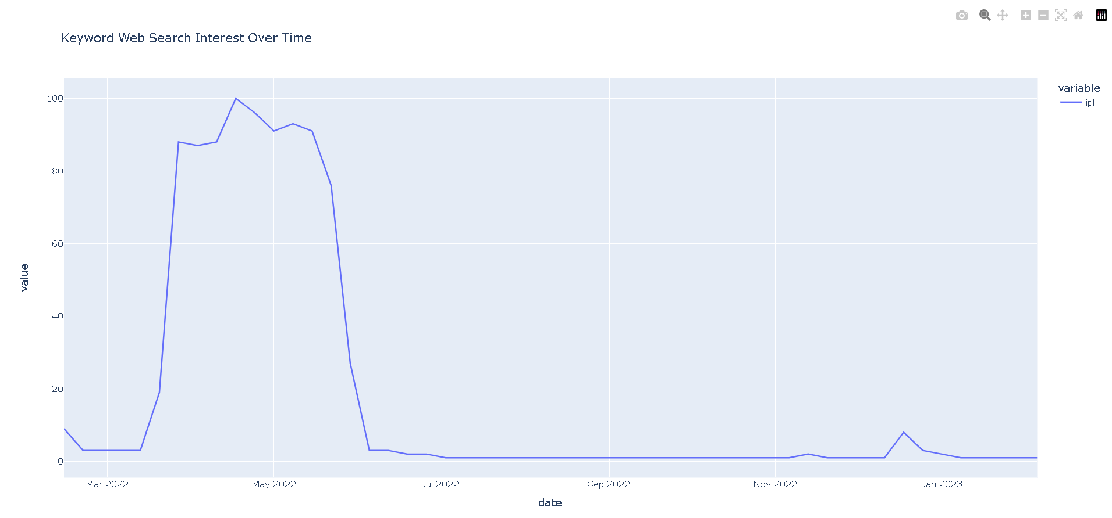
Observation
The graph we got from topic over time for ipl as an example :

Slide 8
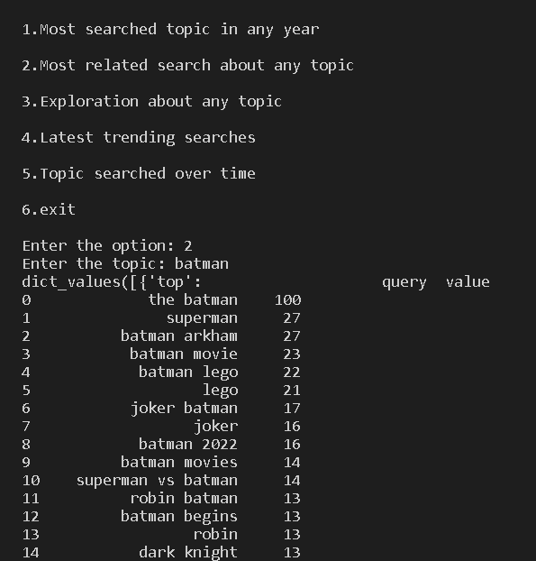
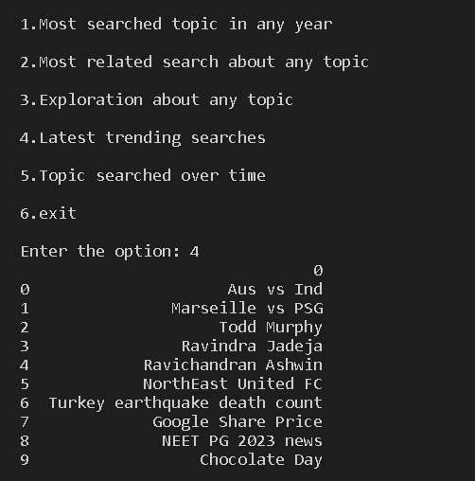
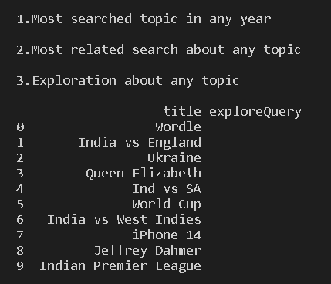
Result

Slide 9
References
W3school python
Geek for geeks

Slide 10



